Slide 1



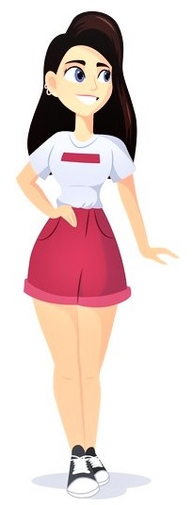
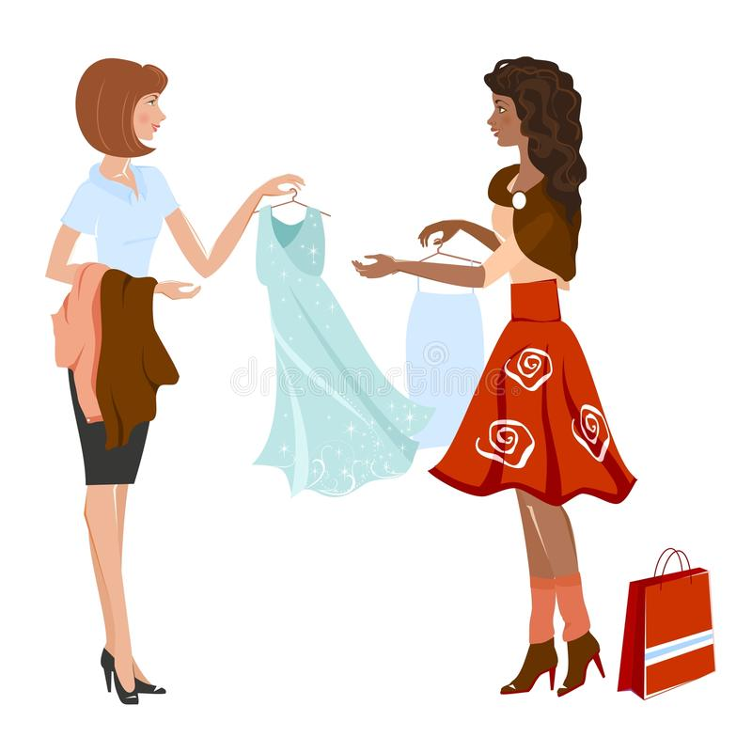
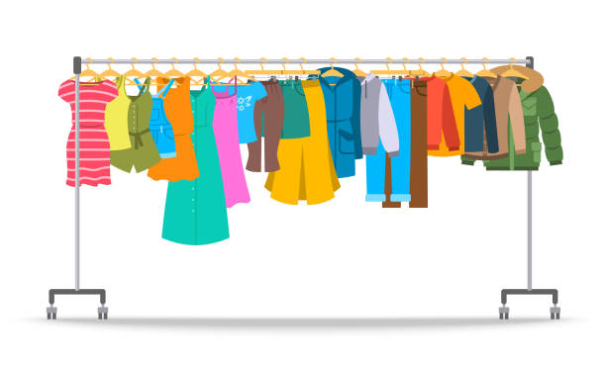
Solution breakthrough
Web/App based secured GUI
Taking user’s photo from webcam as input
Taking accurate body measurements of user
Size recommendation along with cloth recommendation according
to skin tone after virtual fitting of apparel as an additional feature
Output image with the chosen dress
Choosing garment from a cloud database
Video explanation: https://drive.google.com/file/d/1_6rKQvFWKZHts5nY8Gqsat4cKXuyshCQ/view?usp=sharing

Slide 2
Size recommender mechanism
Capturing image/uploading photo by the user
Taking body size measurements as input from user
Size Recommendation using a recommender system

Slide 3
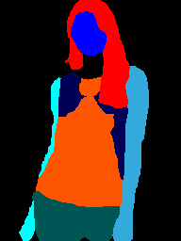
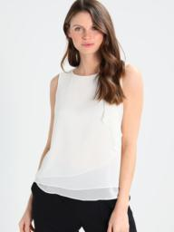
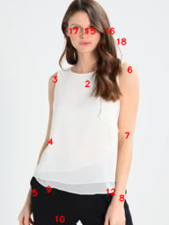
Virtual try-on
Segmentation of user’s body
(parsing)
JPPNet
Model
Goes to CPVTON+
User’s image
Pose estimation
Video explanation: https://drive.google.com/file/d/1rTpOJP3tYutAdvjTHz6Kt37gBpT49Jhe/view?usp=sharing

Slide 4
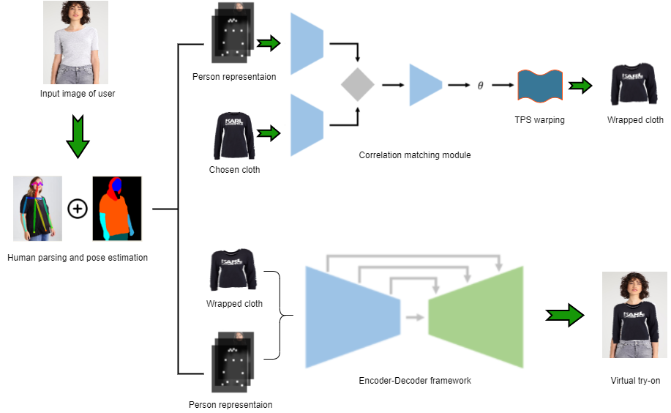
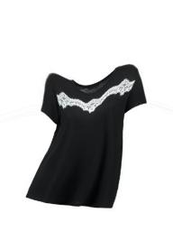
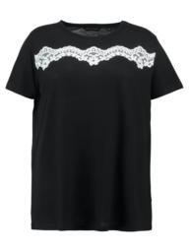
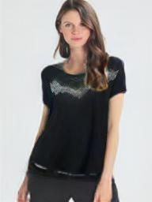

Slide 5
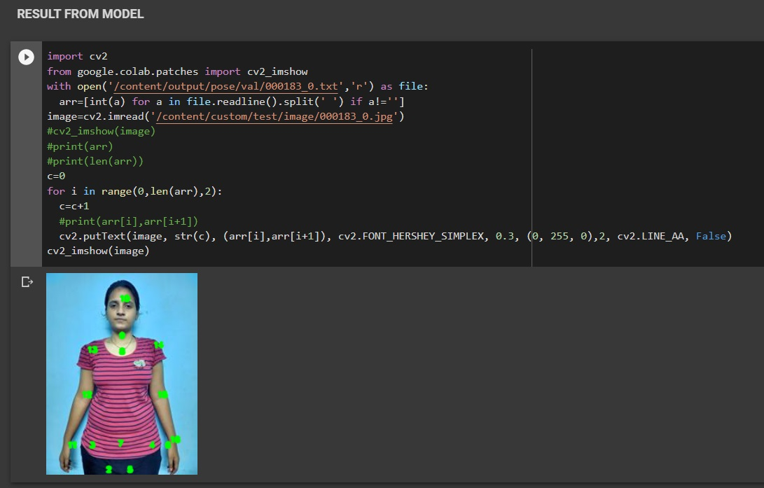
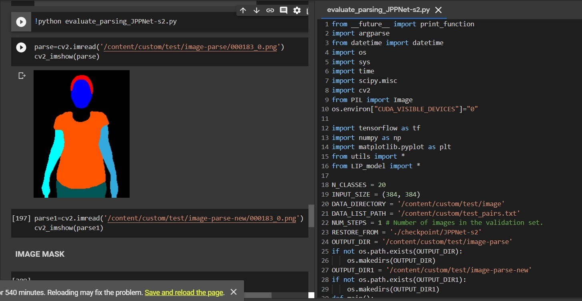
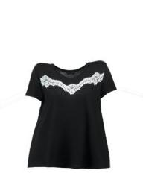
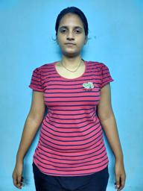
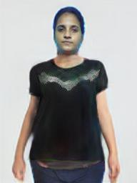
Virtual try-on results

Slide 6
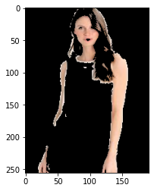
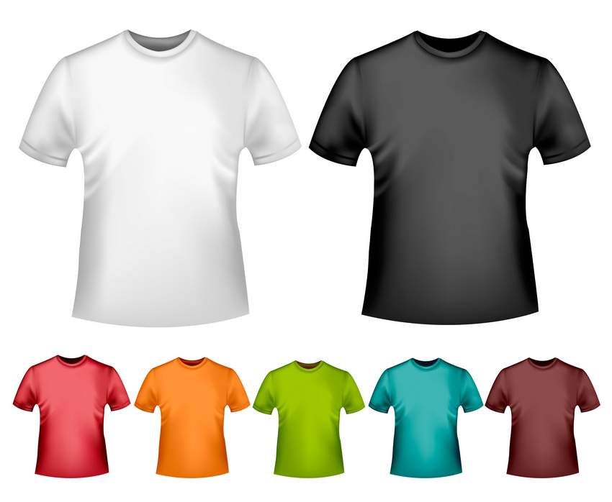
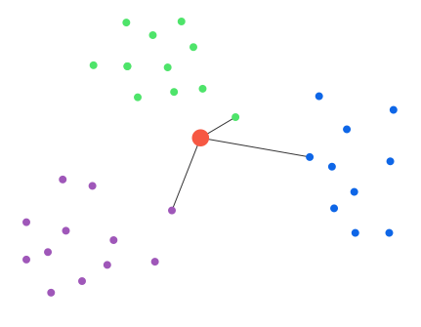
Cloth recommendation based on skin tone of user
Skin-tone detection
module
Skin tone recognition
K-means clustering of 1st five dominant skin tones of user
Cloth recommendation according to skin tone of user
Video explanation: https://drive.google.com/file/d/1HpBDFUUsn6dM4Zy0c-9r09NkhWTiuhKT/view?usp=sharing

Slide 7
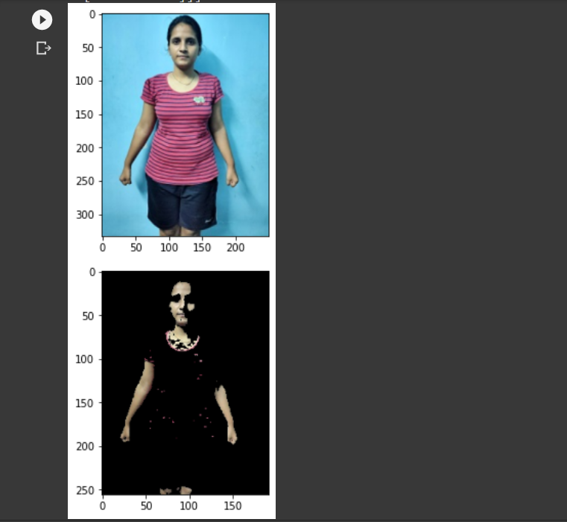
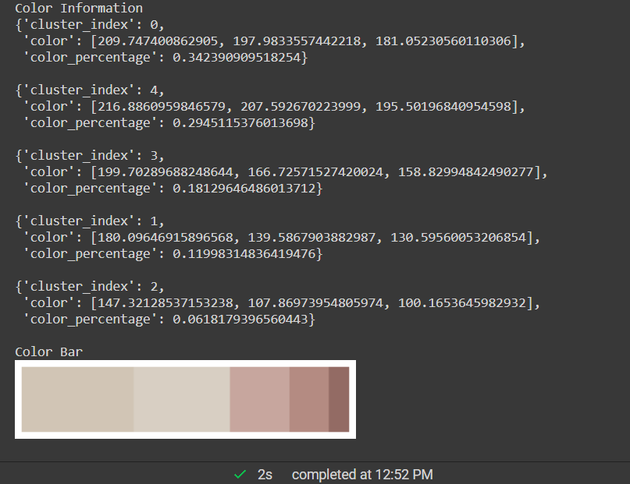
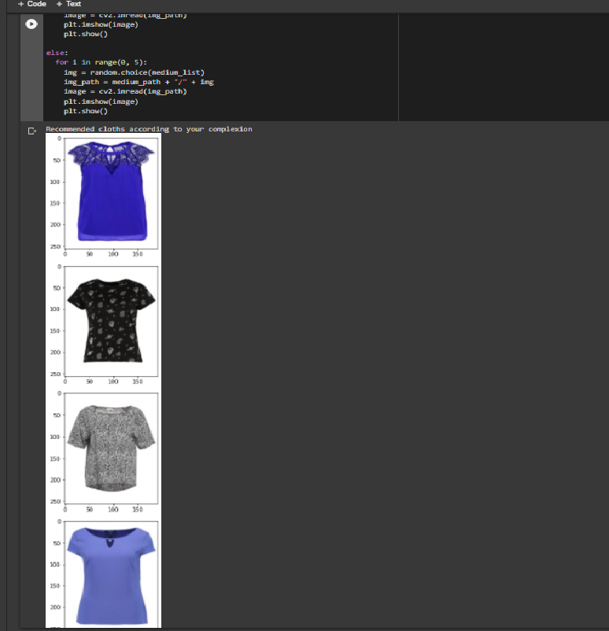
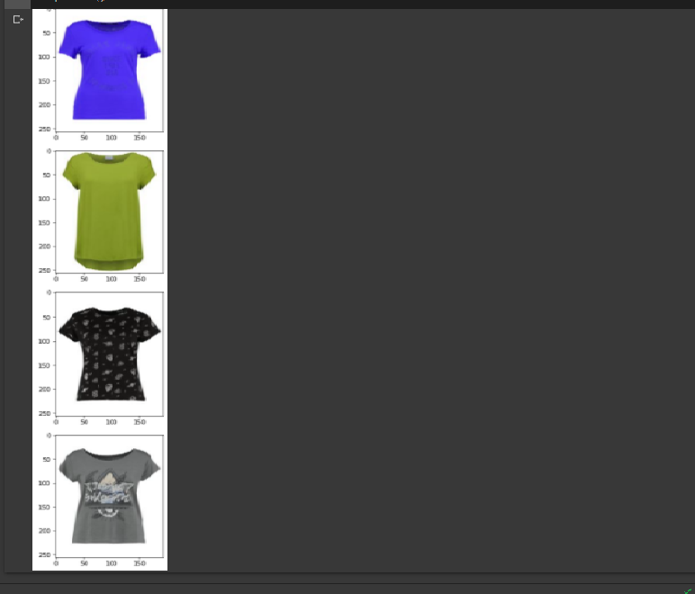
Skin detection
Skin tone recognition
Recommended cloths based on skin tone

